Slide 1
Encoding State Machine Diagrams
(Lect 8)

Slide 2
Translating State Machine to Code
Complicacy:
  State machines have many concepts that are not directly supported in programming languages ---- neither procedural nor OO languages, for example:
    States, events, transitions, composite states, concurrent states, history, etc

Slide 3
Mapping State Model to Program Code
General Idea: How to Generate Code?
on
Initialize
Object
Lamp On
Wait for
Event
on/display(”on”)
Handle
Event
off
off
Lamp
Off
Terminate
Object
stop

Slide 4
How to Encode an FSM?
Three main approaches:
  Doubly nested switch in loop
  State table
  State Design Pattern

Slide 5
3 Principal Ways
Doubly nested switch in loop:
  Scalar variables store state --- Used as switch discriminator for first level switch
  Event type is discriminator in second switch
  Hard to handle concurrent states, composite state, history, etc.
State table: Straightforward table lookup
Design Pattern:
  States are represented by classes
  Transitions handled by methods in classes

Slide 6
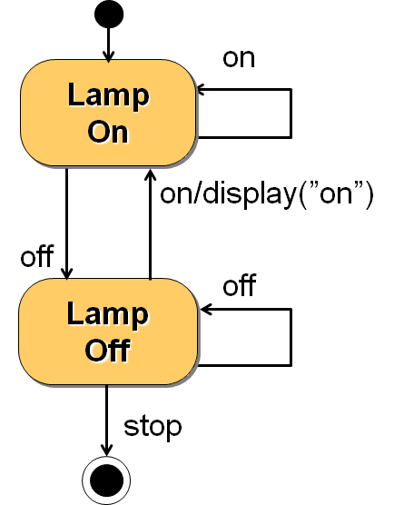
Doubly Nested Switch Approach
int state, event; /* state and event are variables */
while(TRUE){
  switch (state){ /* Wait for event */
  Case state1: switch(event){
  case event1: state=state2; etc…; break;
  case event2:…
  default:
  }
  Case state2:switch(event){…
  …. }
  }}

Slide 7
State Table Approach
From the state machine, we can set up a state transition table with a column for the actions associated with each transition
Present state | Event | Next state | Actions
BTN_off | e1 | BTN_off | none
 | e2 | BTN_on | set red LED flashing
BTN_on | e1 | BTN_on | none
 | e2 | BTN_off | reset red LED flashing

Slide 8
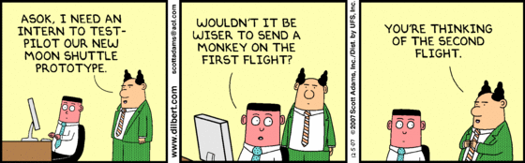

Slide 9
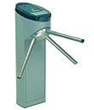
Turnstile: Exercise 2
A turnstile check gate would be installed at a railway station.
When the turnstile is powered on:
  It starts in the locked state.
When a commutator drops a one rupee coin:
  The gate gets unlocked and a message “Gate Open” appears.
  Exactly one person is allowed to pass through before the gate gets locked.
  If more than one person try to pass through, an alarm is sounded and gate gets locked.
Also when any one tries to jump over the gate:
  An alarm is started and gate is locked.

Slide 10
Turnstile Exercise cont…
When the alarm is ON:
  A message “Please wait: Gate temporarily blocked” is displayed.
  If any one still inserts a coin, it return the coin without unlocking the gate.
  The alarm is reset when an attendant swipes a card and the gate starts at the locked state.
When any one inserts a coin when the gate is already open:
  The coin is returned.
If there is a power failure any time:
  The gate gets locked and “Power fail: inoperative” message is displayed and coins are not accepted.

Slide 11
Turnstile: First-Cut State Model
Locked
coin/ Unlock
Unlocked
jump/ Alarm
pass/ Lock
coin/Return coin
Alarm

Slide 12
Turnstile: Final State Model
powerOFF
powerOFF
coin/return
powerON
Locked
coin
Unlocked
pass
cardSwipe
jump
multiple pass||jump
Alarm
Entry/ display

Slide 13
C Code
enum State {Locked, Unlocked, Alarm, PowerOFF};
enum Event {Pass, Coin, multiplePass, jump, cardSwipe};
static State s = Locked;
void Transition(Event e){
switch(s){
case Locked:
switch(e){
case Coin:
s = Unlocked;
Unlock();
break;
case Jump:
s=Alarm;
Alarm();
break;
}
break; cont…

Slide 14
case Unlocked:
switch(e){
case Coin: returnCoin();
break;
case Pass: s = Locked;
Lock();
break;
case jump:
case multiplePass: s=Alarm;
Alarm();
break;}
break;
case Alarm: …. … ….

Slide 15

public class Turnstile{
enum state{ Locked, Unlocked, Alarm}
public Turnstile(){ state=Unlocked;}
public pass(){
if(state== Unlocked) state=Locked;}
public coin(){
switch(state){
case Locked: state=Unlocked; break;
case Unlocked: returnCoin(); break;
}}
public jump(){…}
…}

Slide 16
Ex. 3: Course Registration Software
When a course is created, it is open for registration, and number of students is made 0.
If the course is open and a student registers, the student count incremented.
A course can be cancelled anytime:
  The registered students are notified and their registration cancelled.
If registered student number reaches 100:
  The course is closed for registration, and it is allocated a room and a time slot.

Slide 17
Exercise 3: State Transition Diagram
[ count < 100 ]
register student
create/
count=0
Open
entry: Register student
Increment count
Cancel/
Notify registered students
[ count = 100 ]/
Finalize course
Canceled
Cancel
Closed

Slide 18
Home Work
To withdraw money:
  customer inserts the ATM card.
Authentication is done by checking an entered PIN.
If PIN is incorrect:
  Customer asked to enter PIN again
  On three unsuccessful attempts, the card is seized and account is locked.
On correct entry amount requested is dispensed and card ejected.

Slide 19
Bonus Problem
How to handle code generation for composite AND and OR states?
How to generate code for history state?
Write up + example + code
Submit anytime but before end sem

Slide 20
Use Case Modelling

Slide 21
Diagnostic: Video Store Information System
A Video Store Information System needs to support the following business functions:
  Recording information about videos the store owns
    This database is searchable by staff and all customers
  Find the videos borrowed by a customer
    Access by staff and also the customer. It involves video database searching.
  Staff can record video rentals and returns by customers. It involves video database searching.
  Staff can maintain customer, video and staff information.
  Managers of the store can generate various reports.

Slide 22
Diagnostic Problem: Solution
Video Store Information System
Rent/Return
Videos
«include»
Staff
Search for
Videos
Customer
Maintain
Customers
«include»
Maintain
Videos
Maintain
Staff
Generate
Reports
Manager

Slide 23
Use Case Model of a Problem
Consists of a set of “use cases”
It is the central model:
  Other models must conform to this model…
  Not really an object-oriented model, it is functional model of a system.

Slide 24
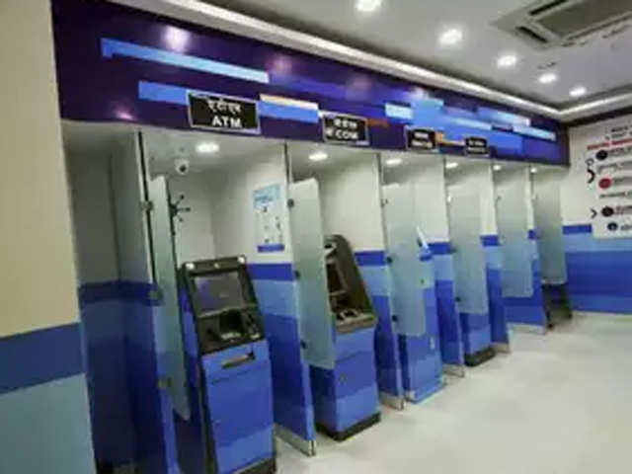
What is a Use Case?
A way in which a system can be used by users to achieve some specific goal. Ex: Withdraw money
Corresponds to a high-level requirement.
Defines external behavior without revealing internal structure of system
Set of related scenarios tied together by a common goal.

Slide 25
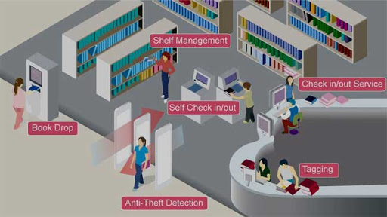
Example Use Cases
Library information system:
    issue-book
    query-book
    return-book
    create-member
    add-book, etc.

Slide 26
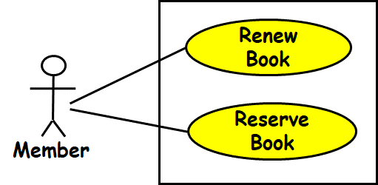
Use Cases Cont…
Normally, use cases are independent of each other
Implicit dependencies may exist
Example: In a Library Automation System, renew-book and reserve-book are independent use cases.
  But in actual implementation of renew-book--- A check is made to see if the book has been reserved using reserve-book.

Slide 27
An Example Use Case Diagram
Tic-tac-toe game
Play Move
Player
Use case model

Slide 28
Representation of Use Cases
A use case is represented by an ellipse
System boundary is represented by a rectangle
Users are represented by stick person icons (actor)‏
Communication relationship between actor and use case by a line
External system by a stereotype
Tic-tac-toe game
Play Move

Slide 29
What is a Connection?
A connection is an association between an actor and a use case.
Depicts a usage relationship…
Connection does not indicate data flow
Tic-tac-toe game
Play Move

Slide 30
System Boundary Box
Release 3
Release 2
Release 1
Search For Items
<<system>>
Payment Processor
Place Order
Customer
Obtain Help
Customer Support
Submit Taxes
Time
Tax Authority

Slide 31
Relationships between Use Cases and Actors
An actor is connected to a use case by an association relation:
  Indicates that the actor and the use case communicate with one another.
update
grades
faculty

Slide 32

Another Example Use Case Diagram
Video Store Information System
Rent Videos
Clerk
<<external system>>
Credit Authorization Service
. . .

Slide 33
Yet Another Use Case Example
Telephone Catalog
Check Status
Salesperson
Place Order
Fill Orders
Shipping Clerk
Customer
Establish credit
Supervisor

Slide 34
Why Develop A Use Case Diagram?
Serves as requirements specification
How is identification of actors useful in software development?
  Identifies different categories of users:
    Helps in implementing appropriate interfaces for each category of users.
  Helps in preparing appropriate documents (e.g. user’s manual).

Slide 35
Exercise1: Video Store Information System
Video Store Information System supports the following business functions:
  Recording information about videos the store owns
    This database is searchable by staff and all customers
  Information about a customer’s borrowed videos
    Access by staff and also the customer. It involves video database searching.
  Staff can record video rentals and returns by customers. It involves video database searching.
  Staff can maintain customer, video and manager can maintain the staff information.
  Manager of the store can generate various reports.

Slide 36
Exercise 1: Solution
Video Store Information System
Rent/Return
Videos
«include»
Staff
Search for
Videos
Customer
Maintain
Customers
«include»
Maintain
Videos
Maintain
Staff
Generate
Reports
Manager

Slide 37
Use Case Description: Issue Video
Actors: Staff
Preconditions:
  Staff has logged on to the system and selected ‘Issue Video’ option
Basic course
  Staff scans the video bar code and the member’s card
  System retrieves member’s account and video details
  Staff presses OK
  System generates transaction summary
Alternative courses
  3. If membership dues pending then …

Slide 38
Use Case Description: Change Flight
Actors: traveler
Preconditions:
  Traveler has logged on to the system and selected ‘change flight itinerary’ option
Basic course
  System retrieves traveler’s account and flight itinerary from client account database
  System asks traveler to select itinerary segment she wants to change; traveler selects itinerary segment.
  System asks traveler for new departure and destination information; traveler provides information.
  If flights are available then
  …
  System displays transaction summary.
Alternative courses
  If no flights are available then …

Slide 39
ATM Money Withdraw Example
Actors: Customer
Pre Condition:
  ATM must be in ready state
Post Condition:
  The current amount of cash in the user account is the amount before withdraw minus withdraw amount
  A receipt was printed on the withdraw amount

Slide 40
ATM Money Withdraw - Mainline Scenario
Actor Actions | System Actions
1. Begins when a Customer arrives at ATM
2. Customer inserts a Credit card into ATM | 3. System verifies the customer ID and status
5. Customer chooses “Withdraw” operation | 4. System asks for an operation type
7. Customer enters the cash amount | 6. System asks for the withdraw amount
 | 8. System checks if withdraw amount is legal
 | 9. System dispenses the cash
 | 10. System deduces the withdraw amount from account
 | 11. System prints a receipt
13. Customer takes the cash and the receipt | 12. System ejects the cash card

Slide 41
ATM Money Withdraw (cont.)
Alternative flow of events:
  Step 3: Customer authorization failed. Display an error message, cancel the transaction and eject the card.
  Step 8: Customer has insufficient fun in his account. Display an error message, and go to step 6.
  Step 8: Customer exceeds his legal amount. Display an error message, and go to step 6.
Exceptional flow of events:
  Power failure in the process of the transaction before step 9, cancel the transaction and eject the card.

Slide 42
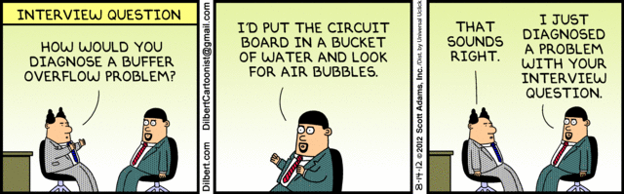

Slide 43
Guidelines for Effective Use Case Writing
Use simple sentence…
Do not have both system and actor doing something in a single step…
  Bad: “Get the amount from the user and give him the receipt.”
Any step should lead to some progress:
  Bad: “User clicks a key”
System
Actor
Actor asks for money
System asks for amount
Actor gives the amount
System produce the money

Slide 44
Identification of Use Cases
1. Actor-based:
  - Identify the actors related to a system or organization.
  For each actor, identify the processes they initiate or participate in.
2. Event-based
  Identify the external events that the system must respond to.
  Relate the events to actors and use cases.

Slide 45
Factoring Use Cases
Two main reasons for factoring:
  Complex use cases need to be factored into simpler use cases
  Helps represent common behavior across different use cases
Three ways of factoring:
  Generalization
  Include
  Extend

Slide 46
Generalization
The child use case inherits the
behavior of the parent use case.
  The child may add to or override some of the behavior of its parent.
parent
child

Slide 47
Generalization Example 1
Registration
Under-graduate
registration
Graduate
registration

Slide 48
Factoring Use Cases Using
Generalization
Pay membership fee
Pay through credit card
Pay through library pay card

Slide 49
Include
When you have a piece of behavior that is similar across many use cases
  Break this out as a separate use-case and let the other ones “include” it
Examples of use case include
  Validate user interaction
  Sanity check on sensor inputs
  Check for proper authorization

Slide 50
Factoring Use Cases Using Include
Base use case
Common
use case
<<include>>
Base use case 2
Base use case 1
<<include>>
<<include>>
<<include>>
<<include>>
Common use case 1
Common use case 2
Common use case 3

Slide 51
Example of Factoring Use Cases Using Include
Issue Book
Renew Book
<<include>>
<<include>>
Check Reservation

Slide 52
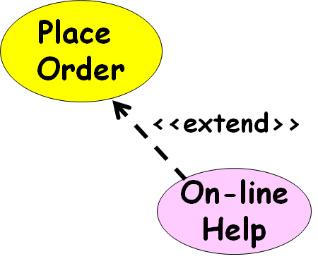
Extend
Use when a use-case can optionally do a little bit more:
  Captures the normal behavior
  Captures the extra behavior in a separate use-case

Slide 53
Factoring Use Cases Using
Extend
Base
use case
Common
use case
<<extend>>

Slide 54
Factoring Use Cases Using
Extend
Order
Item
Show
Catalog
<<extend>>

Slide 55
Extension Point
The base use case may include/extend other use cases:
  At certain points, called extension points.
Note the direction of the arrow
Perform Sale
After checkout
<<extend>>
Gift wrap Product

Slide 56
Use Case Relationships
Order Product
Supply Customer Data
Arrange Payment
<<include>>
<<include>>
<<include>>
Place Order
Cash Payment
Credit Payment
Sales Person
<<extend>>
Salesperson asks for catalog
Request Catalog

Slide 57
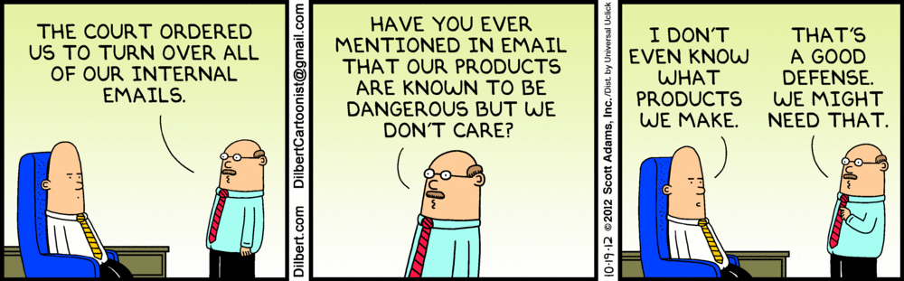

Slide 58
Exercise 2: Use Case Model for Course Management Software
At the beginning of each semester,
  Each professor shall register the courses that he is going to teach.
A student can select up to four-course offerings.
  During registration a students can at any time request a course catalogue showing course offerings for the semester.
  Information about each course such as professor, department and prerequisites would be displayed.
  The registration system sends information to the billing system so the students can be billed for the semester.
For each semester, there is a period of time during which dropping of courses is permitted.
Professors must be able to access the system to see which students signed up for each of their course offerings.

Slide 59
Exercise 2: Model Solution
Course Management Software
Register
Course
offering
See Course List
Show registration
Professor
<<Extend>>
{ reg courses< 5 courses}
Register course
<<External>>
Billing System
Student
{ if today<set date }
Drop Course
Calendar

Slide 60
Effective Use Case Modelling
Use cases should be named and organized from the perspective of the actor.
Use cases should start off simple and at as much high view as possible.
  Can be refined and detailed further.
Use case diagrams represent functionality:
  Should focus on the "what" and not the "how".

Slide 61
Hierarchical Organization of Use Cases
use case 1
use case 3
External users
use case 2
use case 3.1
use case 3.3
Subsystems
use case 3. 2
use case 1
use case 3
Methods
use case 2

Slide 62
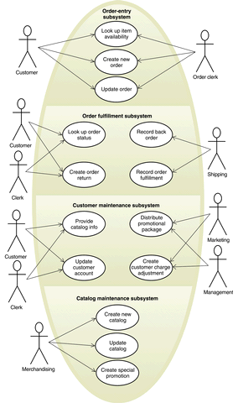
Too many use cases at any level should be avoided!

Slide 63
Use Case Packaging
Accounts
Query balance
Print
Balance sheet
Receive
grant
Make
payments

Slide 64
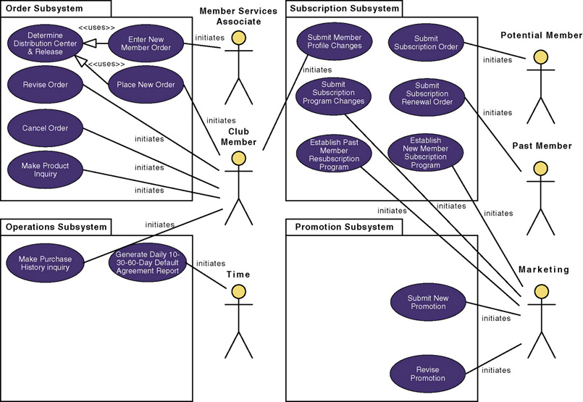
Use-Case Model using Packaging

Slide 65
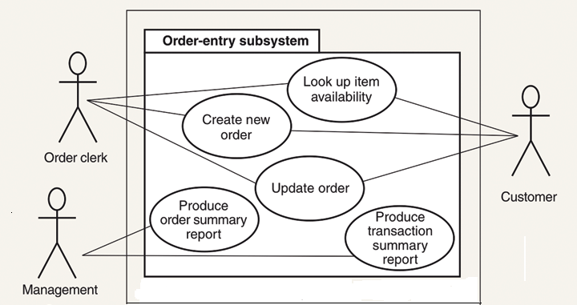
Use Cases of Order Entry Subsystem

Slide 66
Use Case Description
Name
Actors
Trigger
Preconditions
Post conditions
Success Scenario
Alistair Cockburn “Writing Effective Use Cases”
Alternatives flows

Slide 67
Triggers
What starts a use-case?
Examples:
  Customer initiates a claim report by clicking a button on a web page
  Customer inserts ATM card
  System clock is 10:00
  etc.

Slide 68
Preconditions
What the system needs to be true before running the use-case.
Examples:
  The use has logged on
  Requested Book is issued out
  User account has been created
  The membership has expired

Slide 69
Post-Conditions
A post-condition is the outcome of a use-case.
Examples:
  Money is transferred to the user account
  User is logged in
  The file is saved to the hard-disk
Minimal guarantee:
  The things that a system can promise, holding even when the use case execution ended in failure
  Example: Money is not transferred unless authorization is granted by the user
Success guarantee:
  What happens after a successful conclusion of the use-case.
  Example: Transaction logged; Money is transferred

Slide 70
Success Scenario
The success scenario is the main story-line of the use-case:
  Under the assumption that everything is okay, no errors or problems occur
Typically, it is composed of a sequence of action steps
Interaction step
  Administrator enters course name, code and description
  System validates course code
  System adds the course to the db and shows a confirmation message
Validation Step
Interaction Step
Internal Change Step

Slide 71
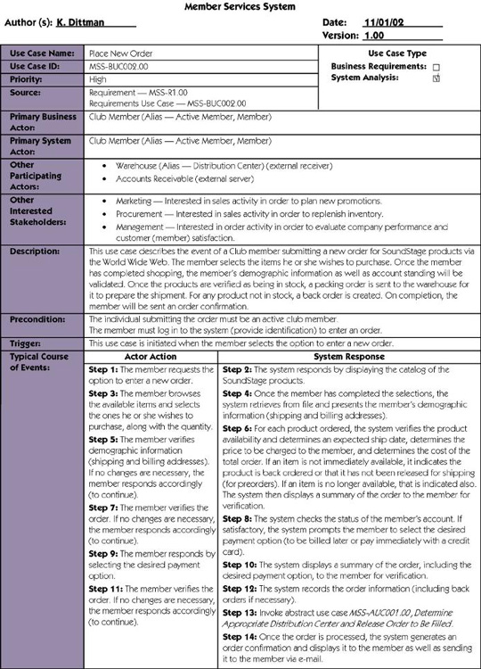

Slide 72
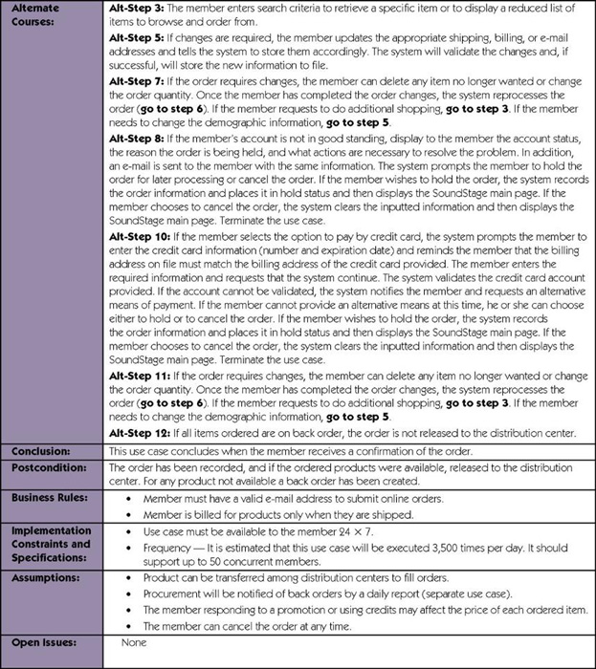

Slide 73
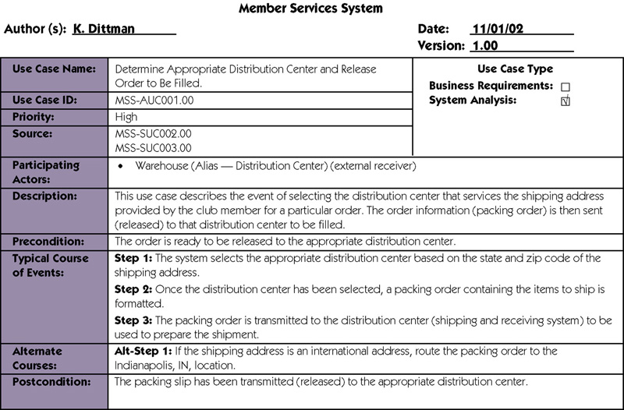

Slide 74
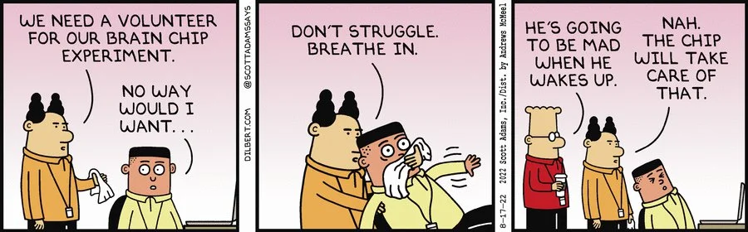

Slide 75
Use Case Style Notes (Ambler, 2005)
A Use case name should begin with a verb.
While use cases do not explicitly imply timing:
  Order use cases from top to bottom to imply timing -- it improves readability.
The primary actors should appear in the left.
Do not use arrows on the actor-use case relationship.
To initiate scheduled events include an actor called “time”
Do not show actors interacting with each other.
<<include>> should rarely nest more than 2 deep.

Slide 76
Exercise: Home Assignment System - Use Case Model
HAS will be used by the instructor to:
  Distribute the homework assignments,
  Review the students’ solutions,
  Distribute suggested solution,
  Assign grade to each assignment.
Students can:
  Download assignments and model solutions
  Submit their assignment solutions and view grade
System:
  Automatically reminds the students a day before an assignment is due.

Slide 77
Quiz: Naïve Solution (Inferior)
Remind Student
Calendar
Distribute Assignments
Get Assignment
Post Model
Solutions
Submit Assignment
<<Extends>>
Student
Distribute Grade
Get Model Solutions
Instructor
View
Assignment
Submissions
Get Grade

Slide 78
Quiz: Alternate (Better) Solution
Distribute Assignments
Post Model
Solutions
Student
Distribute Grade
Instructor
Submit Assignment
Remind Student
Calendar

Slide 79
HW: Video Rental Store Software
A video rental store has a large collection of video CDs and DVDs in VHS and MP4 format as well as music CDs.
A person can become member a member by depositing Rs. 1000 and filling up details such as name, address, and telephone number. A member can cancel his membership and take back his deposit, if he has no dues outstanding against him.
Whenever the store purchases a new item, details such as price and date of procurement are entered. The daily rental charge is also entered by the manager. After passage of a year, the daily rental charge is automatically halved.
A member can, at a time, take on loan at most two video CDs and one music CD. The details are entered by a store clerk and a receipt indicating the daily rental charge should be printed by the software.
Whenever a member returns his loaned item(s), the due amount to be paid is displayed. After the amount is paid, the items are marked returned.
If a customer loses or damages any item, the full price of the item is charged to him and the item is removed from the inventory.
If an item is not lent out by anyone for even once over a year, the item is sold at 10% of the purchase price and is removed from the inventory.
The manager can, at any time, check the profit/loss account.

Slide 80
HW: IIT Security Software
The staff and students of IIT register their vehicle by filling up a form which a security staff would enter into the system.
Each time a vehicle enters or leaves the campus, a camera reads the registration number of the car, and the model of the car. If the car is registered, the check gate should lift automatically to let in (or out) the vehicle. The details regarding the entry and exit of the vehicle are registered in the database. For outside vehicles, the driver needs to enter the purpose of entry, the model number, the registration number, and a photograph of the vehicle is stored in the database.
When an outside vehicle leaves the campus, the details are automatically registered in the database. For any external vehicle that is inside the campus for more than 8 hours, the driver is stopped by the security personnel manning the gate, queried to satisfaction, and the response are recorded. Considering that there have been several incidence of speeding and rough driving, the security personnel are empowered to telephone the registration number of errant vehicles to the main gate. For outside vehicles, the driver is quizzed at the check gate and his future entry is barred if the response is not satisfactory. For inside vehicles, a letter is issued to the dean to deal with the employee or student as the case might be.
The security officer can check the data regarding the number of vehicles going in and coming out of the campus (over a day, month or year), the total number of vehicles currently inside the campus.

Slide 81
HW: Personal Library System
The software is required to manage the collection of books by individuals.
A person can have a few hundreds of books. The details of all the books such as name of the book, year of publication, date of purchase, price, and publisher must be entered. A book is to be given a unique serial number by the computer which would be written by the owner using a pen on the book. Before a friend can be lent a book, he must be registered. The registration data would include name of the friend, address, land line number, and mobile number. Before a friend is issued a book, the various books outstanding against him also with the date borrowed are displayed. The date of issue and the title of the book are stored. When a friend returns a book, the date of return is stored and the book is removed from his borrowing list. Up on query, the software should display the name, address, and telephone numbers of each friend against whom books are outstanding along with the titles of the outstanding books and the date on which those were issued.
The owner of the library software, when he borrows books from his friends, would enter the details regarding the title of books borrowed, and the date borrowed. Similarly, the return details of books would be entered. The software should be able display all the books borrowed from various friends. The owner should be able to query about the availability of a particular book, the total number of books in the personal library,

Slide 82
HW:Students’ Auditorium Management Software
Various types of social and cultural events are conducted in the student auditorium. There are two categories of seats: balcony and ordinary seats. The maximum number of balcony seats that can be booked per ticket is 2.
The show manager fixes the prices of the two categories of seats for a specific show, depending on the popularity of a show.
The show manager also enters the show dates, the number of shows on any particular date and the show timings. It is expected that the software would support a functionality to let the show manager configure the different show parameters.
The system should let the spectators query the availability of different classes of seats for a show on-line. A spectator can book a seat for a single show only through regular cash payment and the software should print out the ticket showing the seat numbers allocated. A spectator should be able to cancel his booking before 3 clear days of the show.

